Slide 1
New Topic: Probability Probability Expressions
Miss L
Year 12 Essentials

Slide 2
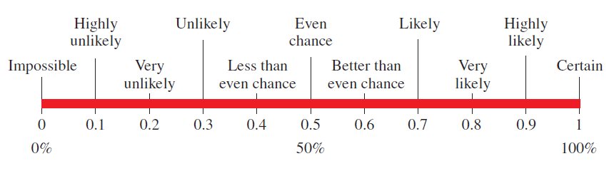
24
7
30
Probability Expressions
Date
EQ – What language do we use to describe probability?
Is defined as the chance of an event occurring
Probability may be written as percentages, decimals and fractions
A scale is used to allocate the probability of an event
Probability Expressions

Slide 3
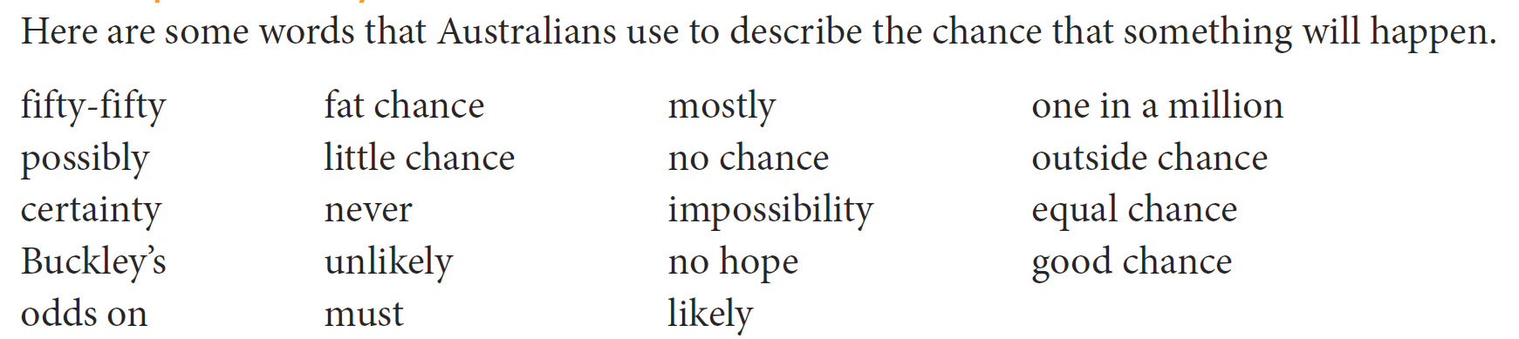
Group Activity
Certain or Very Likely to Happen Could Happen Won’t or very unlikely to happen

Slide 4
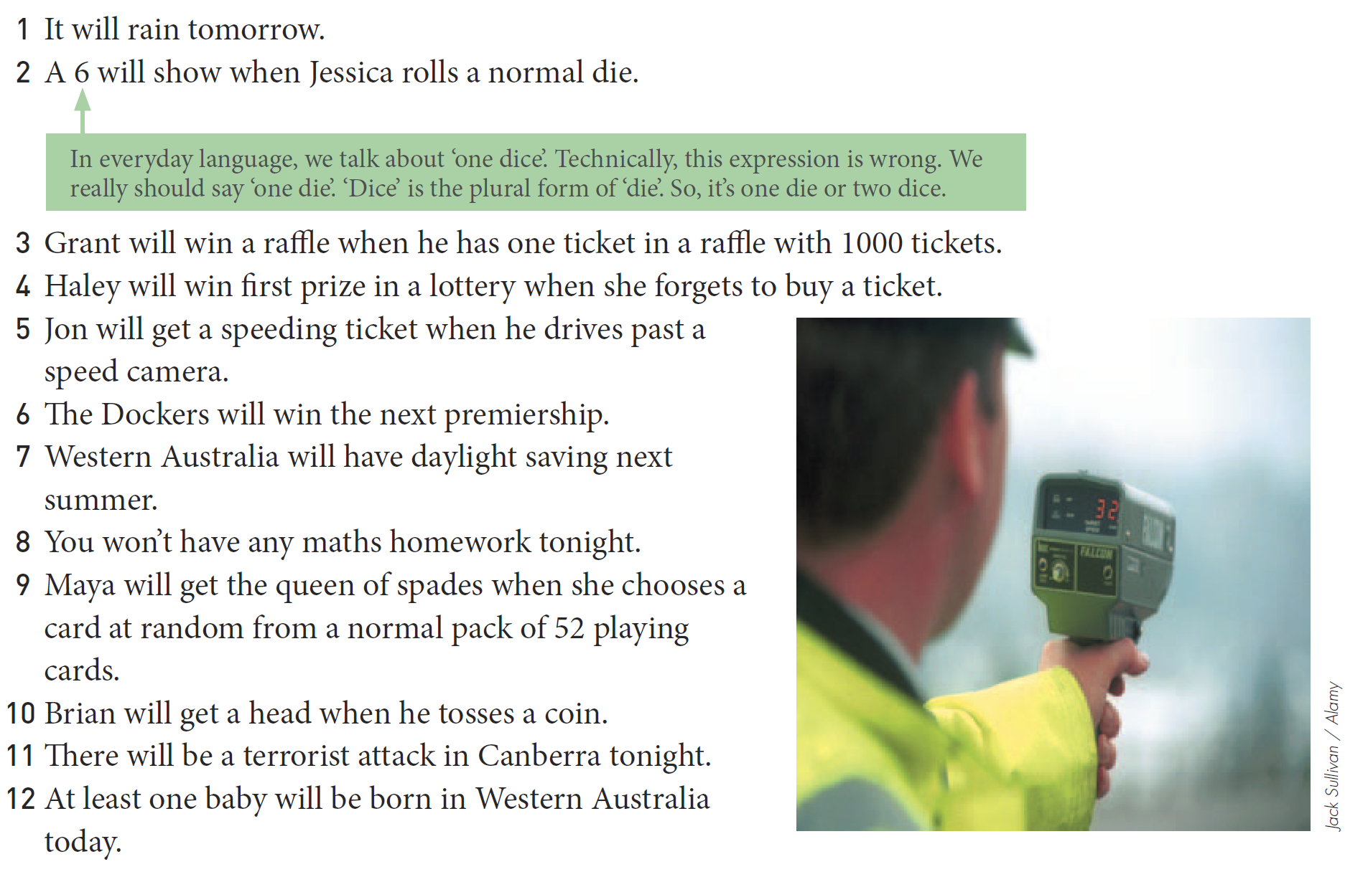
Practice

Slide 5

24
7
30
Probability Expressions
Date
EQ – What language do we use to describe probability?
Probability can be expressed in a mathematical way:
Probability Expressions
based as a faction of the number of favourable outcomes to the number of possible outcomes.

Slide 6

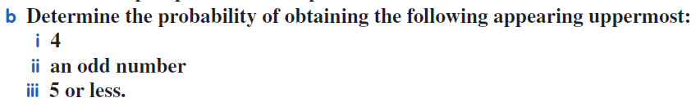
Practice

Slide 7


Slide 8
